Slide 1
Forms IN HTML
I
PrePARED BY
Anood nazeer

Slide 2
Topics
Introduction
Form tag
Form attributes
Input controls
Conclusion – The power of HTML forms

Slide 3
HTML Forms
A form is a container for input elements on a web page.
Input elements contain data that is send to the web server for processing
There are two basic parts of form
Designing of forms using fields, labels, buttons, etc…
Processing of the form after submit.

Slide 4
<form> tag
The HTML <form> element is used to create an HTML form for user input :
Syntax :
<form>
form elements
</form>
The <form> elements is a container for different types of input elements,
such as : text fields , checkboxes, radio button, file, buttons , etc….

Slide 5
<form> attributes
Action
The action attributes defines the action to be performed when the form I submitted.
Usually the form data send to a file on the server when the user click on the submit button.
Target
The target attributes specifies where to display the response that is received after
submitting the form.
Method
The method attribute specifies the HTTP method to be used when submitting the form data.

Slide 6
Form elements
The HTML <form> elements can contain one or more of the following form
Elements :
<input>
<button>
<label>
<option>
<select>
<text area>

Slide 7
Input controls
<input> - text ,radio buttons, checkboxes, files,
passwords
<button> - buttons
<textarea> - multiline text
<select> - drop down list

Slide 8
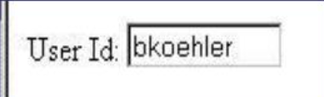
<input type=“text”>
The <input type="text"> element creates a text box where users can type a single line of text.
Attributes
name --- control name
value --- initial value
size --- initial display width
maxlength --- maximum number of characters a used may enter
User Id : <input type =“text” name=“userid” size =“10” maxlength=“8”

Slide 9
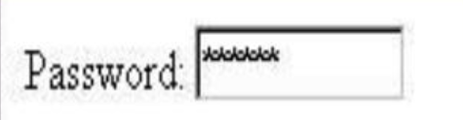
<input type=“password”>
.
The <input type="password"> element creates a text box where users can type a password, and the characters are hidden for privacy
Attributes : same as for “text”
Characters typed are rendered as *s
Secure only in this user agent –
Actual value sent in the clear over HTTP
Password :
<input type=“password” name=“passwd” size=“10 maxlength=“8”>

Slide 10
<input type=“hidden>
the type="hidden" attribute is used in <input> elements to store data that is not visible to the user but can be sent to the server when the form is submitted.
Attributes :
Name –control name
value –initial (only value)
Password :
<input type=“hidden” name=“sccret” value=“sssshhhh!”>

Slide 11
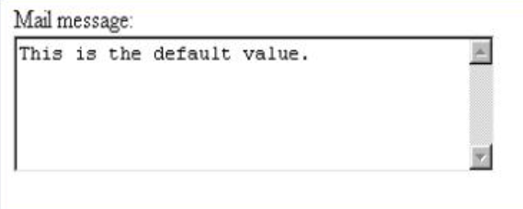
<textarea>
Creates a multiline input text area
Attributes
rows – the number of lines of input text.
Cols – in average character widths.
Name – the name of the control.
message :
<textarea rows=“5” cols=“40” name=“name”> This is the default value</textarea>

Slide 12
<input type =“radio”>
Creates a radio button.
the "radio" input type, which creates a radio button, allowing users to select only one option from a group of related choices within a form.
Attributes :
Name – control name
Value – value associated with selected radio button.
Checked – initial state of the button
A mutullay exclusive group is created by creating several elements with the same name attribute.

Slide 13
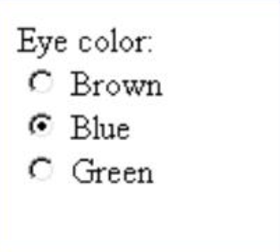
Eye color :
<input type=“radio” name=“eye-c”
Value=“brown”>brown <br>
<input type=“radio” name=“eye-c”
Value=“blue” checked=“checked”>blue <br>
<input type=“radio” name=“eye-c”
Value=“green”>green

Slide 14
<input type=“checkbox”
A checkbox in HTML is a square box element that allows users to
select one or more options from a list by clicking on it,
essentially acting like a tick box where you can choose to
"check" or "uncheck" an option;
it's created using the <input type="checkbox"> tag in HTML code.
Attrbutes
Name – control name
Value –value associated with selected checkbox
Checked –initial state of the checkbox

Slide 15
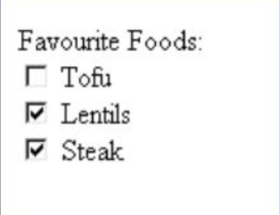
Favourite foods :
<input type="checkbox" name=“ffood" value=“tofu"> Tofu <br>
<input type="checkbox" name=" ffood " value=“lentils" > Lentils <br>
<input type="checkbox" name=" ffood " value=“steak">Steak <br>

Slide 16
<select>
Select element containing one or more <option> elements.
Attributes :
Name – control name
Size – number of list item visible
It create a dropdown menu, you use the <select> element with <option> elements inside it.
<option> element
Defines one option in a list
Attributes :
Selected – indicates that the option is pre selected.
Value – initial value of the control.
Label –alternate string to display rather than the content of the element.

Slide 17
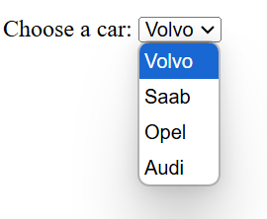
Select a car : <select name="cars" size=“1"> <option value="volvo">Volvo</option> <option value="saab">Saab</option> <option value="opel">Opel</option> <option value="audi">Audi</option> </select>

Slide 18
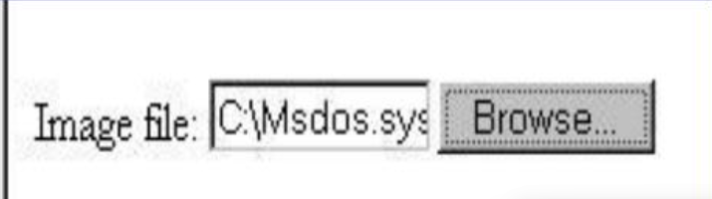
<input type=“file”>
Allows an entire file to be submitted with a
Form
Attributes
Name –control name
Value –initial file to use
Image file :
<input type=“file” name=“img.file”
Value=“c:\boot.int” size=“10”>

Slide 19
Buttons
Submit – causes the form to be submitted to the web server
Reset –causes all input controls within the <form> to be restored to their
initial button.
Attributes :
Name – control name
Type –submit, reset, image, button
Image creates a graphical submit button
Button creates a generic button
Value – text to display on button control

Slide 20
Conclusion: The power of HTML forms
Purpose : HTML forms are essential for collecting and processing user input, enabling
dynamic user interaction.
Key elements :
Form tags, inputs, and other interactive components like dropdown, checkbox and buttons.
Attributes like methods and action ensure proper data handling.
Benefits :
Seamless user experience and data submission.
Integrates with back-end technologies for powerful functionality.
Impact : From simple login pages to complex surveys, forms are the backbone of web interactivity

